Slide 1
Approximate Q-Learning
Scott O’Hara
Metrowest Developers Machine Learning Group
06/10/2020

Slide 2
References
CS188 - Introduction to Artificial Intelligence course at University of California, Berkeley:
http://ai.berkeley.edu/home.html
http://gamescrafters.berkeley.edu/~cs188/sp20/
CS181 - Machine Learning course at Harvard University:
Lectures and notes from multiple offerings of CS181: Spring 2009, 2011, 2014 and 2017.
The Hundred-Page Machine Learning Book, A. Burkov, Publisher: Andriy Burkov, 2019. http://themlbook.com/ ,
Reinforcement learning: an Introduction, R. S. Sutton and A. G. Barto, Second edition. Cambridge, Massachusetts: The MIT Press, 2018.

Slide 3
Reinforcement Learning

Slide 4
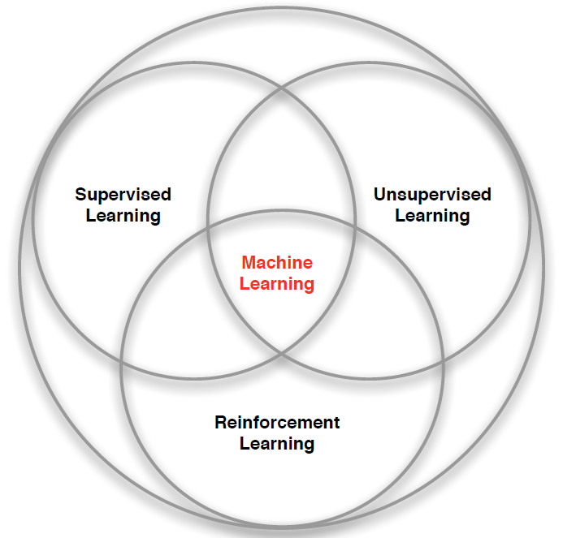
3 branches of Machine Learning
Credit: adapted from lecture slides David Silver, DeepMind, “Introduction to Reinforcement Learning

Slide 5

1. Supervised Learning
$Labeled Data=\left\{\left(x_{1},y_{1}\right),…,\left(x_{n},y_{n}\right)\right\}$ with feature vector $x_{i}$ and label $y_{i}.$
Train a model $f$on the labeled data.
Predict label $y=f\left(x\right)$ for unlabeled data.
Examples: linear regression, decision trees, SVMs, k-nearest neighbors.
Credit: adapted The Hundred-Page Machine Learning Book, A. Burkov, 2019.

Slide 6

2. Unsupervised Learning
$Unlabeled Data=\left\{x_{1},,…,x_{n}\right\}$ of feature vectors $x_{i}$.
Create a model $f$on the unlabeled data.
Transform feature vector $x$ into:
ID $y=f\left(x\right)$ (Clustering)
Vector $x′=f\left(x\right)$ (Dimensionality Reduction)
Clustering examples: K-means, HAC
Dimensionality reduction examples: PCA, UMAP
Credit: adapted The Hundred-Page Machine Learning Book, A. Burkov, 2019.

Slide 7

3. Reinforcement Learning
Agent
State: s’
Reward: r
Actions: a
Environment
Agent “lives” in an environment and can perceive the state of that environment as a vector of features.
Agent learns to act to maximize the expected average reward
Agent knows the current state s, takes an action a, receives a reward r and observes the next state s’.
$S_{0}, A_{0}, R_{0},S_{1}, A_{1}, R_{2},S_{2}, A_{2}, R_{2},…,S_{n}, A_{n}, R_{n},S_{T}$
Credit: adapted The Hundred-Page Machine Learning Book, A. Burkov, 2019.

Slide 8
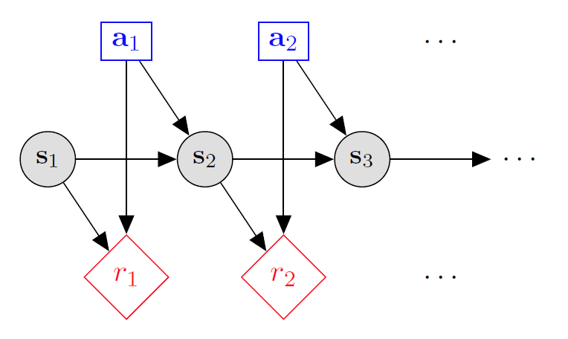

Markov decision processes
States: $s_{1},…,s_{n}$
Actions: $a_{1},…,a_{m}$
Reward model:
$R\left(s,a,s′\right)∈R$
Transition model:
$T\left(s,a,s′\right)=$ $P\left(s′ | s, a\right)$
Discount factor: $γ∈\left[0,1\right]$
<https://en.wikipedia.org/w/index.php?title=Markov_decision_process&oldid=855934986> [accessed 11 September 2018]

Slide 9





Example: gridworld
A maze-like problem
The agent lives in a grid
Walls block the agent’s path
Noisy movement: actions do not always go as planned
80% of the time, the action North takes the agent North (if there is no wall there)
10% of the time, North takes the agent West; 10% East
If there is a wall in the direction the agent would have been taken, the agent stays put
The agent receives rewards each time step
Small “living” reward each step (usually negative)
Big rewards come at the end (good or bad)
Goal: maximize sum of rewards
Notes:
[cut demo of moving around in grid world program]

Slide 10
Example: gridworld
States: <x, y> locations
Actions: move north, south, east or west.
Reward model:
+1 if robot moves to <3, 2>
-1 if robot moves <3, 1>
otherwise, get “living reward”.
Transition model:
n – probability of unintended (noisy) action.
1-n probability of intended action.
stay put if you move into a wall.
Notes:
python gridworld.py -k 40 -w 200 -s 2.0 -a q –v [-p]

Slide 11
Tabular Q-Learning

Slide 12
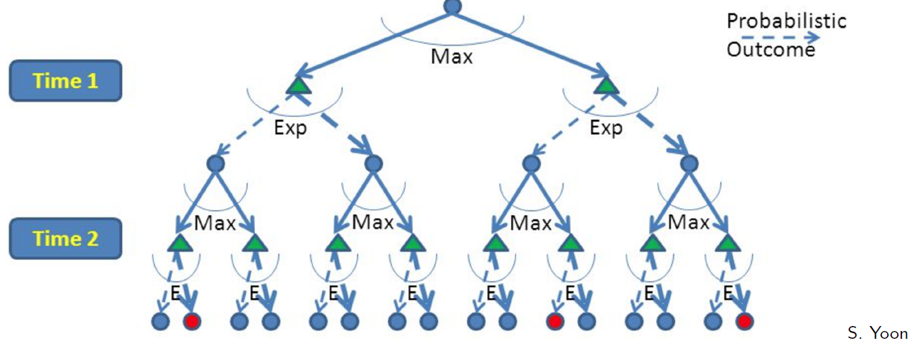
RL is like A game against Nature
Reinforcement learning is like a game-playing algorithm.
Nodes where you move are called states: S ( )
Nodes where nature “moves” are called Q-states: <S,A> ( )
Credit: CS188 – Intro to AI, UC Berkeley, ai.berkely.edu

Slide 13
Quantities to optimize
The state-value function:
V(s) = the expected utility of starting in state s and acting optimally afterwards.
The action-value function:
Q(s,a) = the expected utility of starting in state s, taking action a, and acting optimally afterwards.
The policy:
π(s) = defines the action to take in every state s.
s
s is a state
a
(s, a) is a q-state
s, a
s,a,s’
(s,a,s’) is a transition
s’
Credit: CS188 – Intro to AI, UC Berkeley, ai.berkeley.edu
Notes:
Demo just shows V and Q values, snapshots on next slides.

Slide 14
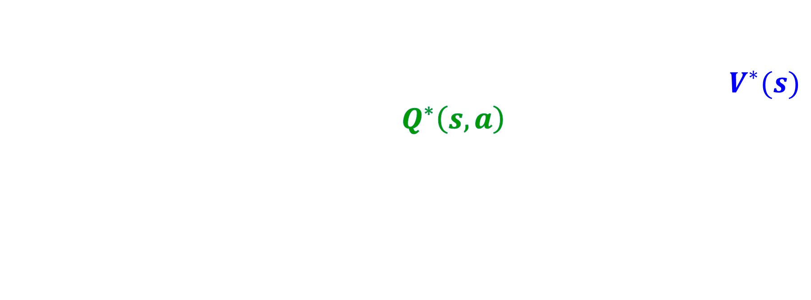
The Bellman Optimality Equations
The Bellman Optimality Equations define a relationship that, when satisfied, guarantees that the state-value function $V^{∗}(s)$ and the state-action function $Q^{∗}\left(s,a\right)$ are optimal for every state and action.
This in turn guarantees that the policy $π$is optimal, which is designated $π^{∗}$.
Credit: CS188 – Intro to AI, UC Berkeley, ai.berkeley.edu
Credit: CS181 – Machine Learning, D. Parkes, Harvard Univ, Spring 2017
Notes:
Let’s start by equations that characterize these quantities through mutual recursions. [step through this by writing on slide, one step at a time]
Recursive characterization of V* in terms of V*; not necessarily helpful; but it is a characterization.
Note: this is a set of equations that needs to be satisfied; but it could have multiple solutions (it does not, but at this stage of our knowledge it could).

Slide 15
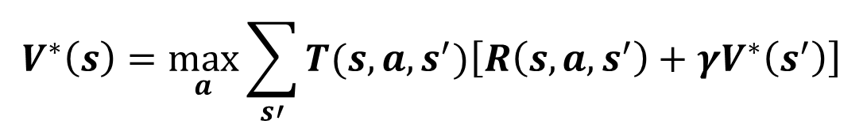
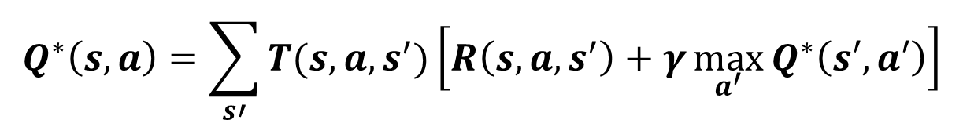
The Bellman Optimality Equations
State-Value Equation:
s
$$V^{∗}\left(s\right)=\max_{a}{\sum_{s′}{T(s,a,s^{′})\left[R\left(s,a,s^{′}\right)+γV^{∗}\left(s^{′}\right)\right]}}$$
a
s, a
s,a,s’
Action-Value Equation:
s’
$$Q^{∗}\left(s,a\right)=\sum_{s′}{T(s,a,s^{′})\left[R\left(s,a,s^{′}\right)+γ\max_{a^{′}}{Q^{∗}\left(s′,a′\right)}\right]}$$
Simplifying Assumption: rewards are fixed for (s, a, s’)
Credit: CS188 – Intro to AI, UC Berkeley, ai.berkeley.edu
Credit: CS181 – Machine Learning, D. Parkes, Harvard Univ, Spring 2017
Notes:
Let’s start by equations that characterize these quantities through mutual recursions. [step through this by writing on slide, one step at a time]
Recursive characterization of V* in terms of V*; not necessarily helpful; but it is a characterization.
Note: this is a set of equations that needs to be satisfied; but it could have multiple solutions (it does not, but at this stage of our knowledge it could).

Slide 16
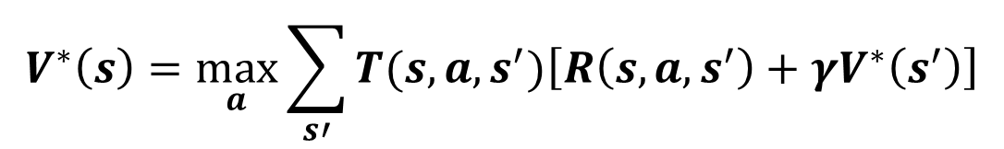
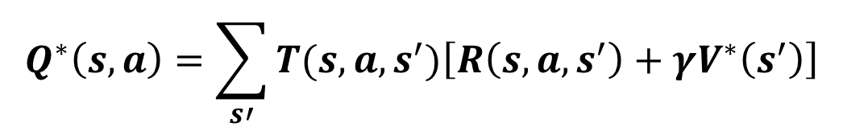
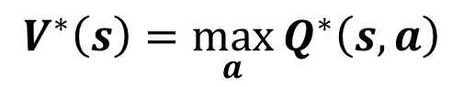
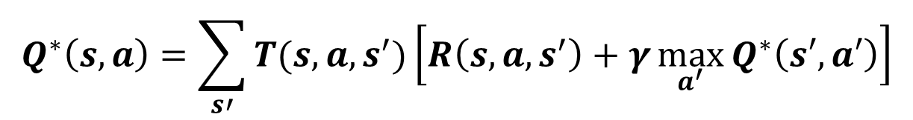
Mutual Recursion
State-Value Equation:
V*(s)
$$V^{∗}\left(s\right)=\max_{a}{\sum_{s′}{T(s,a,s^{′})\left[R\left(s,a,s^{′}\right)+γV^{∗}\left(s^{′}\right)\right]}}$$
a
Q*( s, a)
$$V^{∗}\left(s\right)=\max_{a}{Q^{∗}\left(s,a\right)}$$
s,a,s’
Action-Value Equation:
V*(s’)
$$Q^{∗}\left(s,a\right)=\sum_{s′}{T(s,a,s^{′})\left[R\left(s,a,s^{′}\right)+γ\max_{a^{′}}{Q^{∗}\left(s′,a′\right)}\right]}$$
$$Q^{∗}\left(s,a\right)=\sum_{s′}{T(s,a,s^{′})\left[R\left(s,a,s^{′}\right)+γV^{∗}\left(s^{′}\right)\right]}$$
Notes:
Let’s start by equations that characterize these quantities through mutual recursions. [step through this by writing on slide, one step at a time]
Recursive characterization of V* in terms of V*; not necessarily helpful; but it is a characterization.
Note: this is a set of equations that needs to be satisfied; but it could have multiple solutions (it does not, but at this stage of our knowledge it could).

Slide 17
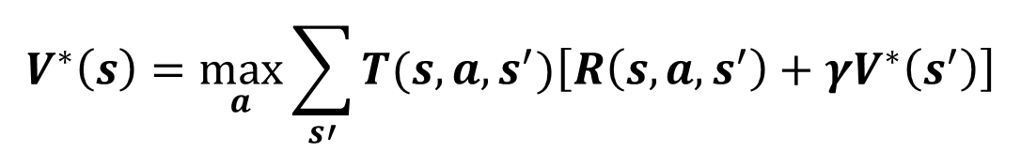
The optimal State-Value Equation V*
$$V^{∗}\left(s\right)=\max_{a}{\sum_{s′}{T(s,a,s^{′})\left[R\left(s,a,s^{′}\right)+γV^{∗}\left(s^{′}\right)\right]}}$$
Focusing on different Bellman Equations gives different algorithms
The V* equation gives rise to these dynamic programming algorithms previously discussed:
Value Iteration
Policy Iteration
s
a
s, a
s,a,s’
s’
Credit: CS188 – Intro to AI, UC Berkeley, ai.berkeley.edu
Credit: CS181 – Machine Learning, D. Parkes, Harvard Univ, Spring 2017
Notes:
Let’s start by equations that characterize these quantities through mutual recursions. [step through this by writing on slide, one step at a time]
Recursive characterization of V* in terms of V*; not necessarily helpful; but it is a characterization.
Note: this is a set of equations that needs to be satisfied; but it could have multiple solutions (it does not, but at this stage of our knowledge it could).

Slide 18
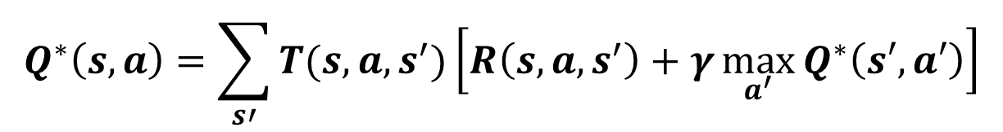
The optimal Value utility Equation Q*
$$Q^{∗}\left(s,a\right)=\sum_{s′}{T(s,a,s^{′})\left[R\left(s,a,s^{′}\right)+γ\max_{a^{′}}{Q^{∗}\left(s′,a′\right)}\right]}$$
The Q* equation gives rise to the Q-Learning algorithm.
Credit: CS188 – Intro to AI, UC Berkeley, ai.berkeley.edu
Credit: CS181 – Machine Learning, D. Parkes, Harvard Univ, Spring 2017
Notes:
Let’s start by equations that characterize these quantities through mutual recursions. [step through this by writing on slide, one step at a time]
Recursive characterization of V* in terms of V*; not necessarily helpful; but it is a characterization.
Note: this is a set of equations that needs to be satisfied; but it could have multiple solutions (it does not, but at this stage of our knowledge it could).

Slide 19
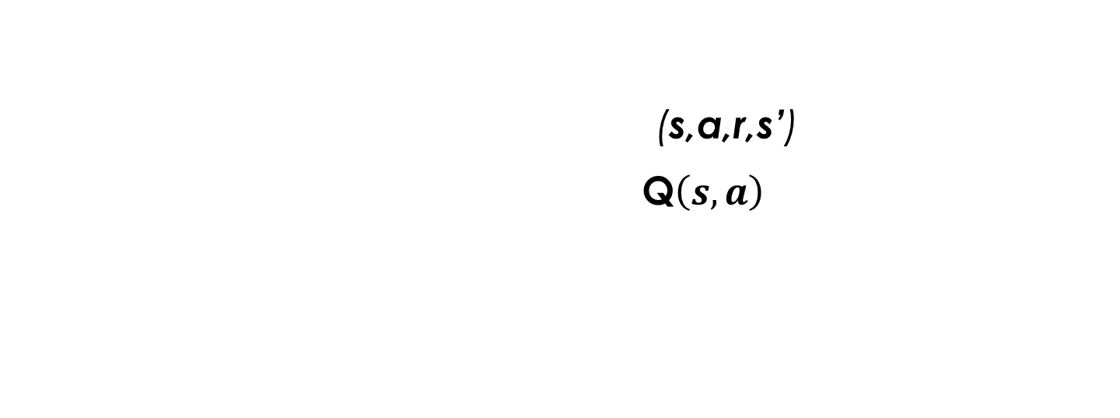
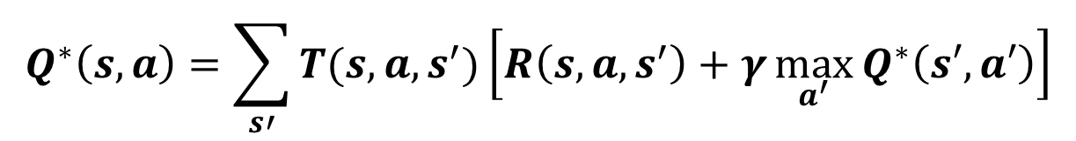
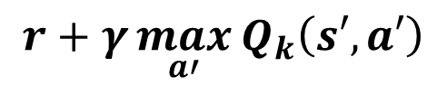
From equation to Update Rule
What to do about T(s,a,s’) and R(s,a,s’), since we don’t have these functions?
$$Q^{∗}\left(s,a\right)=\sum_{s′}{T(s,a,s^{′})\left[R\left(s,a,s^{′}\right)+γ\max_{a^{′}}{Q^{∗}\left(s′,a′\right)}\right]}$$
Use sampling to learn Q(s,a) values as you go
Receive a sample transition: (s,a,r,s’)
Consider your old estimate: $\text{Q}\left(s,a\right)$
Consider your new sample estimate:
Incorporate the new estimate into a running average based on the learning rate $α$:
$$r+γ\max_{a′}{Q_{k}\left(s′,a′\right)}$$
$$Q\left(s,a\right)←Q\left(s,a\right)+α\left[r+γ\max_{a′}{Q_{k}\left(s′,a′\right)}−Q\left(s,a\right)\right]$$

Slide 20
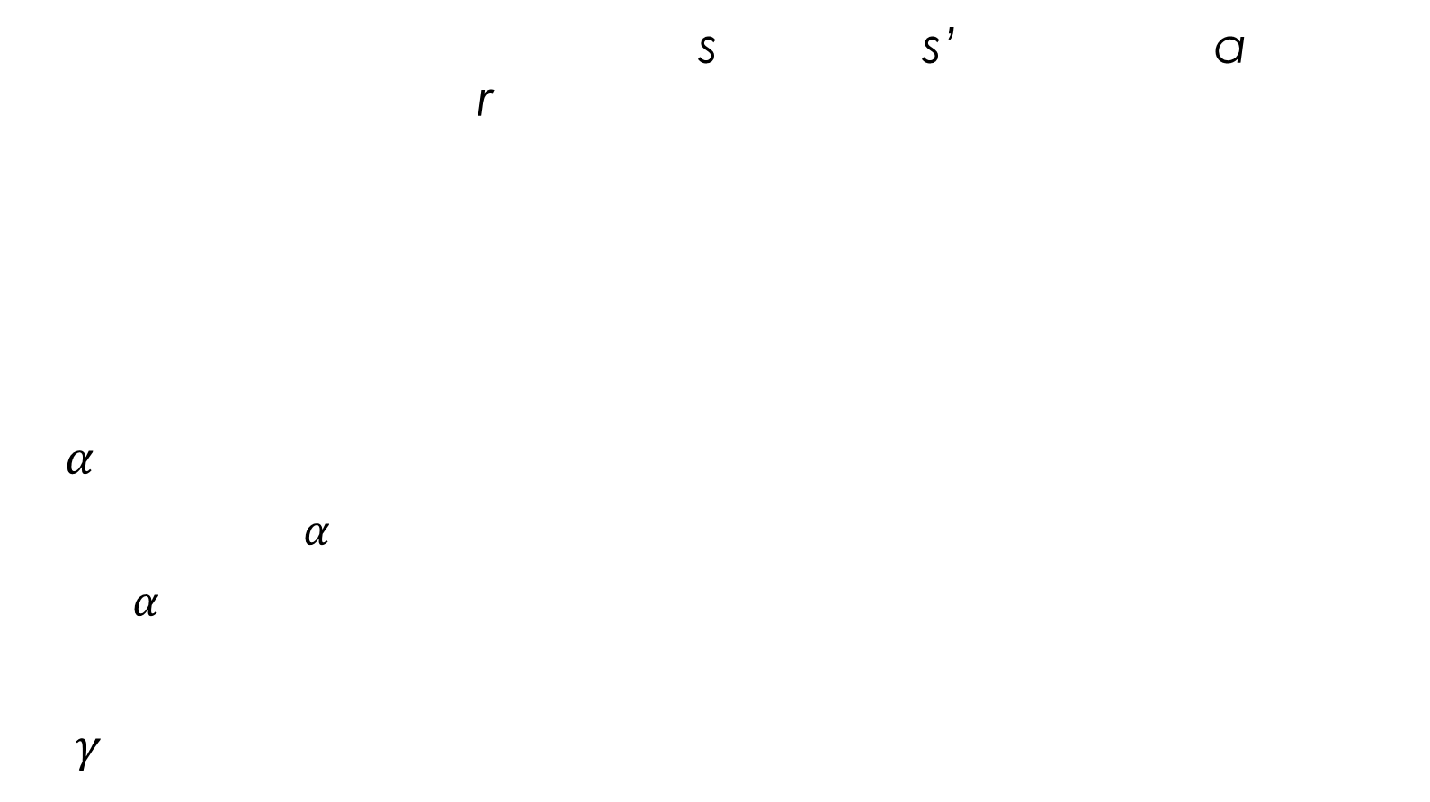
Q-Learning update rule (2)
On transitioning from state s to state s’ on action a, and receiving reward r, update:
$α$ is the learning rate
A large $α$ results in quicker learning but may not converge.
$α$ is often decreased as learning goes on.
$γ$ is the discount rate i.e., discounts future rewards.
target
current
$$Q_{k+1} \left(s,a\right)←Q_{k}\left(s,a\right)+α\left[r+γ\max_{a′}{Q_{k}\left(s′,a′\right)}−Q_{k}\left(s,a\right)\right]$$

Slide 21
choosing an action: exploration vs exploitation
How should an agent choose an action? An obvious answer is simply to follow the current policy. However, this is often not the best way to improve your model.
Exploit: use your current model to maximize the expected utility now.
Explore: choose an action that will help you improve your model.

Slide 22

ϵ-Greedy Method
With probability 1 - ϵ:
$A_{t}=argmax Q_{t}(s,a)$, select action with maximum value.
With probability ϵ:
$A_{t}=$ select with equal probability an action at state s
from all possible actions.

Slide 23
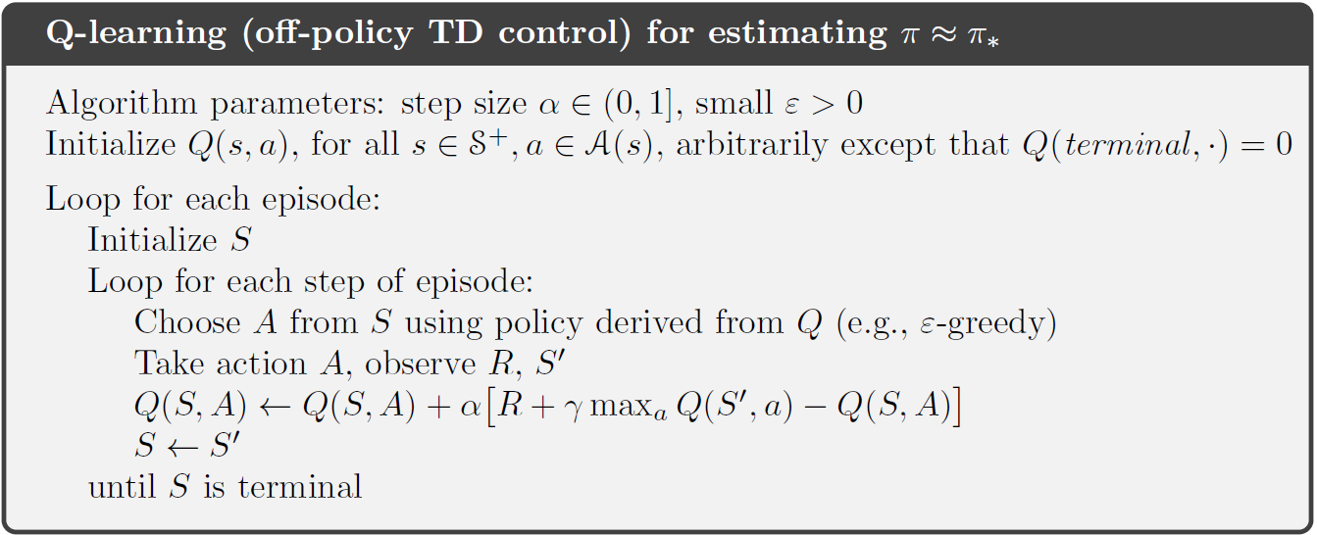
Tabular Q-Learning algorithm
Credit: Reinforcement Learning: an Introduction, R. Sutton and A. Barto, 2018.

Slide 24
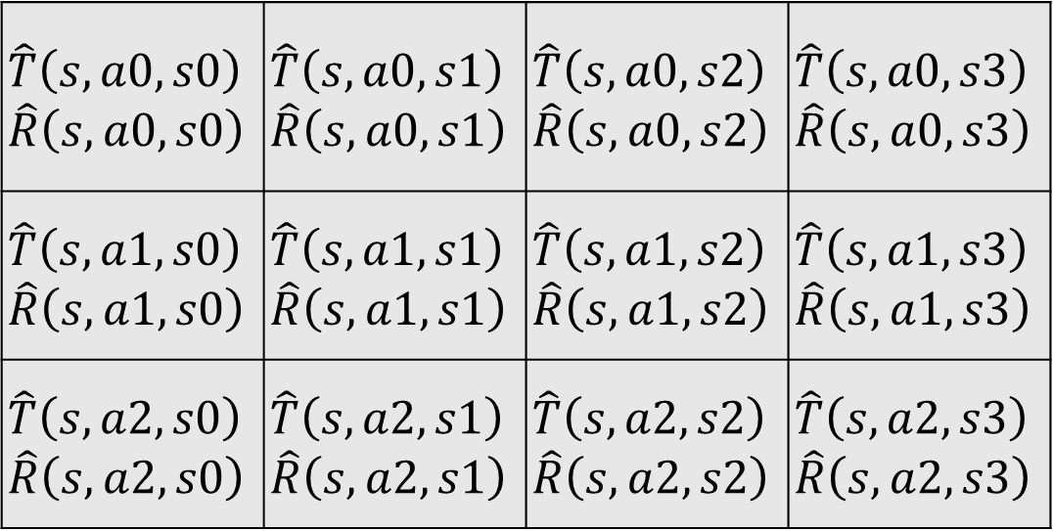
Transition/reward parameter tables
For every state s, there is a transition table T and a reward table R:
State s’
$$\hat{T}\left(s,a0,s0\right)$$ $$\hat{R}\left(s,a0,s0\right)$$ | $$\hat{T}\left(s,a0,s1\right)$$ $$\hat{R}\left(s,a0,s1\right)$$ | $$\hat{T}\left(s,a0,s2\right)$$ $$\hat{R}\left(s,a0,s2\right)$$ | $$\hat{T}\left(s,a0,s3\right)$$ $$\hat{R}\left(s,a0,s3\right)$$
$$\hat{T}\left(s,a1,s0\right)$$ $$\hat{R}\left(s,a1,s0\right)$$ | $$\hat{T}\left(s,a1,s1\right)$$ $$\hat{R}\left(s,a1,s1\right)$$ | $$\hat{T}\left(s,a1,s2\right)$$ $$\hat{R}\left(s,a1,s2\right)$$ | $$\hat{T}\left(s,a1,s3\right)$$ $$\hat{R}\left(s,a1,s3\right)$$
$$\hat{T}\left(s,a2,s0\right)$$ $$\hat{R}\left(s,a2,s0\right)$$ | $$\hat{T}\left(s,a2,s1\right)$$ $$\hat{R}\left(s,a2,s1\right)$$ | $$\hat{T}\left(s,a2,s2\right)$$ $$\hat{R}\left(s,a2,s2\right)$$ | $$\hat{T}\left(s,a2,s3\right)$$ $$\hat{R}\left(s,a2,s3\right)$$
Action a

Slide 25
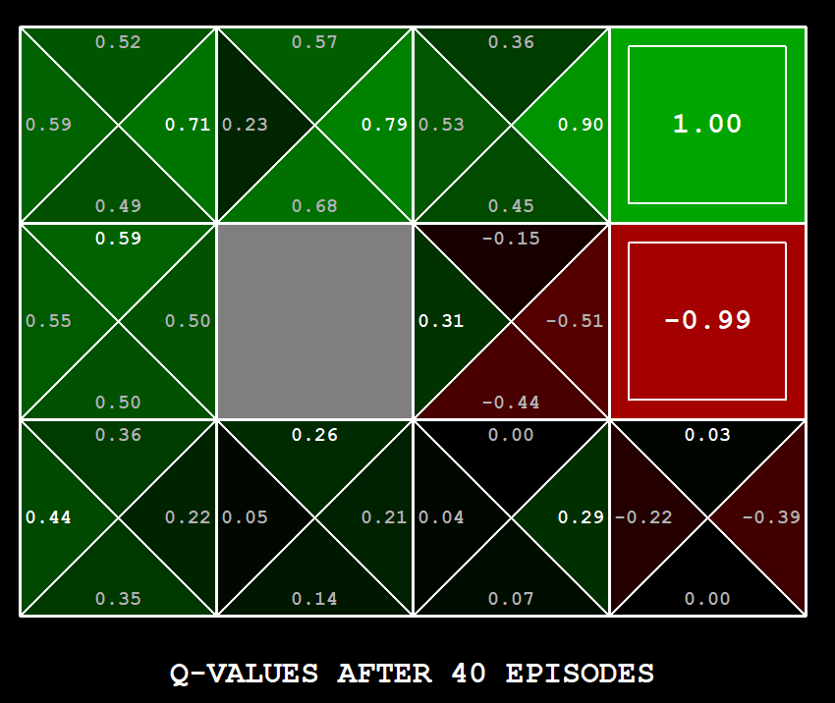
Q-Learning Example: gridworld
Notes:
python gridworld.py -k 40 -w 200 -s 2.0 -a q –v [-p]

Slide 26

Approximate Q-Learning
Credit: CS188 – Intro to AI, UC Berkeley, ai.berkely.edu

Slide 27
Approximate Reinforcement Learning
Problems with tabular reinforcement learning:
Large state spaces need large amounts of memory.
Large state spaces require a long time to fill with accurate values.
Key question: How can experience with a limited subset of the state space be usefully generalized to produce a good approximation over a much larger subset?
Generalization can be accomplished with function approximation, which is an instance of supervised learning.
In theory, any of the supervised learning techniques can be used as a function approximator, though some approaches are better than others.

Slide 28
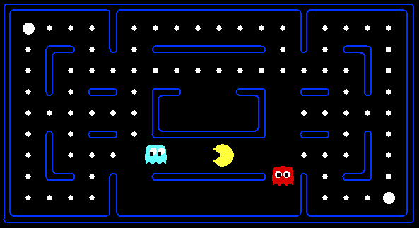



Example: Pacman
Let’s say we discover through experience that this state is bad:
In naïve q-learning, we know nothing about this state:
Or even this one!
Credit: CS188 – Intro to AI, UC Berkeley, ai.berkeley.edu

Slide 29
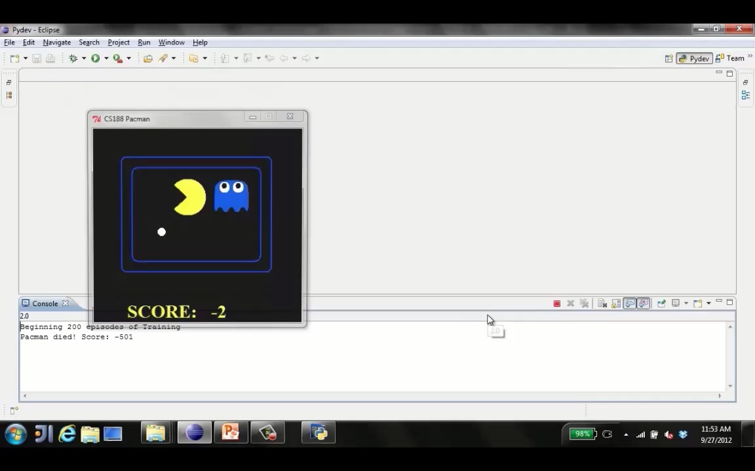
Tiny pacman demo 1
Credit: CS188 – Intro to AI, UC Berkeley, ai.berkeley.edu

Slide 30
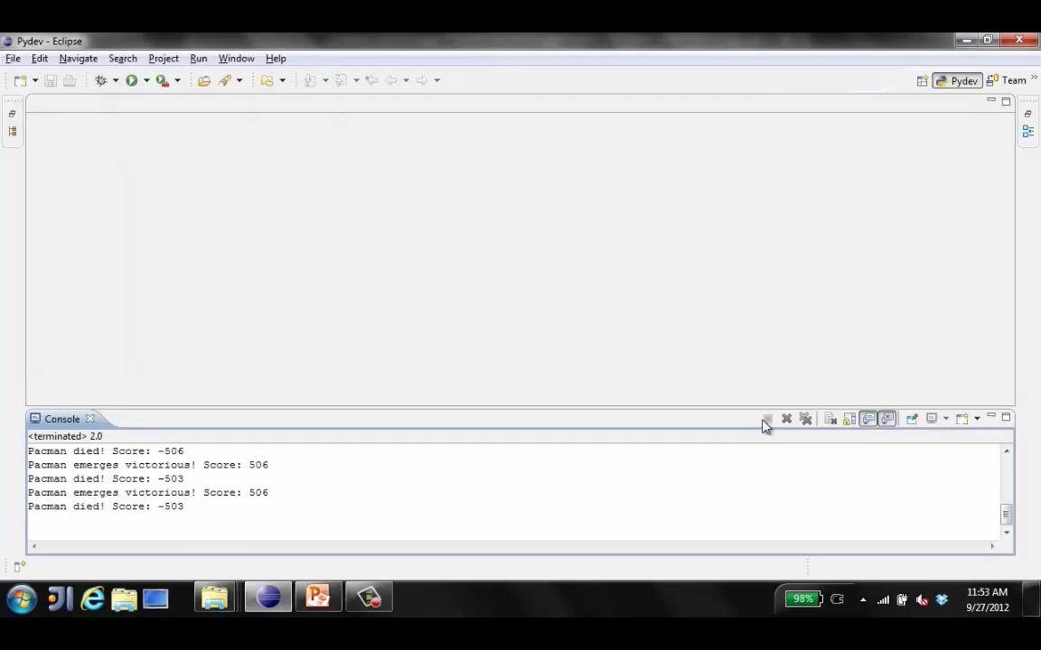
Tiny pacman demo 2
Credit: CS188 – Intro to AI, UC Berkeley, ai.berkeley.edu

Slide 31
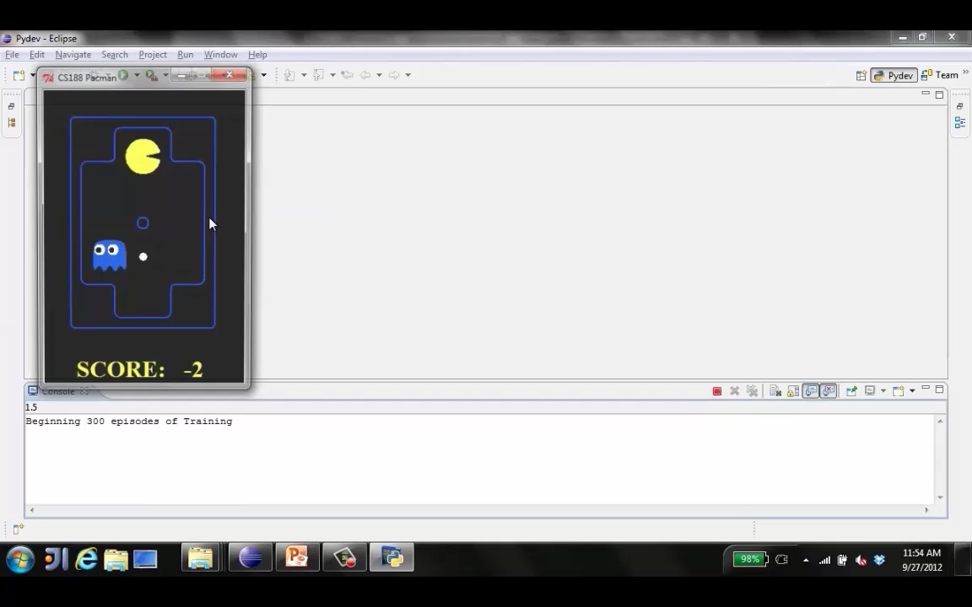
Tiny pacman demo 3
Credit: CS188 – Intro to AI, UC Berkeley, ai.berkely.edu

Slide 32


Feature-Based Representations
Solution: describe a state using a vector of features (properties)
Features are functions from states to real numbers (often 0/1) that capture important properties of the state
Example features:
Distance to closest ghost
Distance to closest dot
Number of ghosts
1 / (dist to dot)²
Is Pacman in a tunnel? (0/1)
Is it the exact configuration on this slide?
…… etc.
Can also describe a q-state (s, a) with features (e.g. action moves closer to food)
Credit: CS188 – Intro to AI, UC Berkeley, ai.berkeley.edu

Slide 33

Linear Value Functions
Using a feature representation, we can write a q function (or value function) for any state using a few weights:
$V\left(s\right)=w_{1}f_{1}\left(s\right)+$ $w_{2}f_{2}\left(s\right)$ $+$ …+ $w_{n}f_{n}\left(s\right)$
Q$\left(s,a\right)=w_{1}f_{1}\left(s,a\right)+$ $w_{2}f_{2}\left(s,a\right)$ $+$ …+ $w_{n}f_{n}\left(s,a\right)$
Advantage: our experience is summed up in a few powerful numbers
Disadvantage: states may share features but actually be very different in value!
Credit: CS188 – Intro to AI, UC Berkeley, ai.berkeley.edu

Slide 34


Q-learning with linear Q-functions
$Q\left(s,a,\overline{w}\right)=w_{1}x_{1}\left(s,a\right)+$ $w_{2}x_{2}\left(s,a\right)$ $+$ …+ $w_{n}x_{n}\left(s,a\right)$
Exact Q’s:
transition = (s,a,r,s’)
difference = $\left[r+γ\max_{a′}{Q(s^{′},a^{′})}\right]−Q(s,a)$
$Q\left(s,a\right)←Q\left(s,a\right)+α\left[\text{difference}\right]$
Approximate Q’s:
$Q\left(s,a,\overline{w}\right)={\overline{w}}^{T}\overline{x}$
$∇Q\left(s,a,\overline{w}\right)=\overline{x}$ for linear functions
$w_{i}←w_{i}+α\left[\text{difference}\right]\frac{∂x_{i}{(s,a)}}{∂w_{i}}$
$w_{i}←w_{i}+α\left[\text{difference}\right]x_{i}$
Credit: CS188 – Intro to AI, UC Berkeley, ai.berkeley.edu

Slide 35
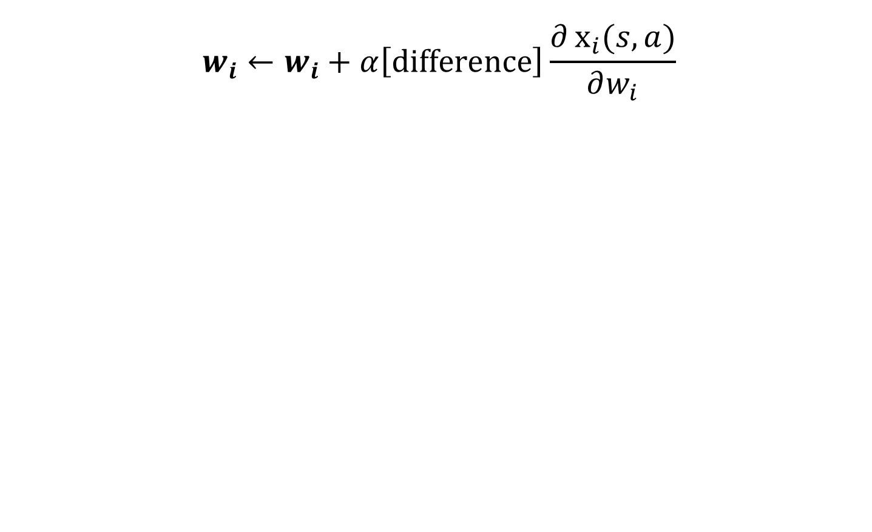
Intuitive Interpretation
$$w_{i}←w_{i}+α\left[\text{difference}\right]\frac{∂x_{i}{(s,a)}}{∂w_{i}}$$
Adjust weights of active features.
If something good happens, increase the features that were on i.e., prefer similar states more that have that state’s features.
If something unexpectedly bad happens, blame the features that were on i.e., prefer similar states less that have that state’s features.
Credit: CS188 – Intro to AI, UC Berkeley, ai.berkeley.edu

Slide 36
Q-Learning update ruleS: Tabular vs. Linear Action-value Function
Tabular Update Rule:
target
current
$$Q_{k+1} \left(s,a\right)←Q_{k}\left(s,a\right)+α\left[r+γ\max_{a′}{Q_{k}\left(s′,a′\right)}−Q_{k}\left(s,a\right)\right]$$
Linear Action-Value Update Rule:
target
current
$$\overline{w}←\overline{w}+α\left[R+γ\max_{a′}{\hat{q}\left(S^{′},A^{′},\overline{w}\right)}−\hat{q}\left(S,A,\overline{w}\right)\right]∇\hat{q}\left(S,A,\overline{w}\right)$$

Slide 37
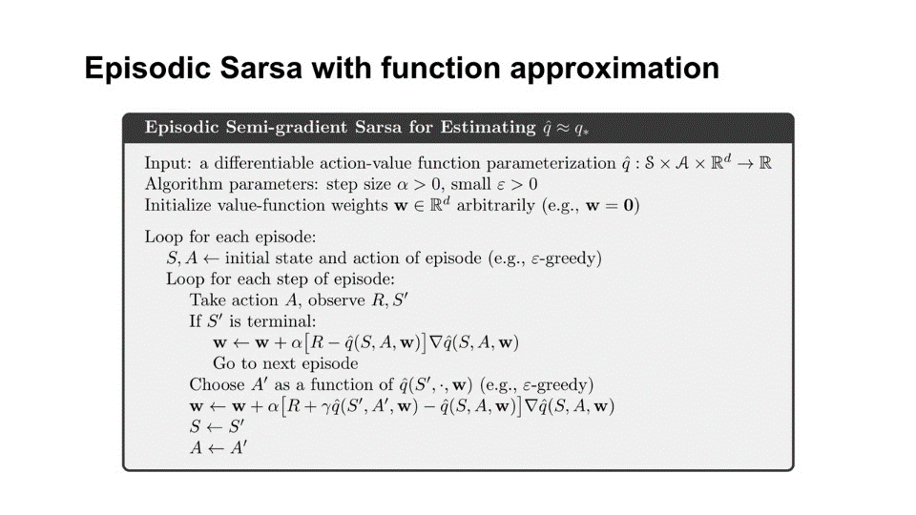
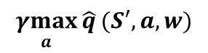
Approximate Q-Learning algorithm
Q-Learning
$$\underset{a}{γmax}{\hat{q}}(S′,a,w)$$
Credit: Reinforcement Learning: an Introduction, R. Sutton and A. Barto, 2018.

Slide 38
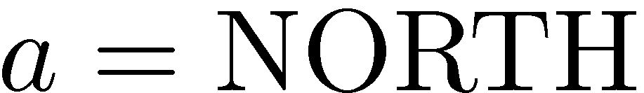










Example: Q-Pacman
$$Q\left(s,a\right)=4.0x_{DOT}\left(s,a\right)−1.0x_{GST}\left(s,a\right)$$
$$x_{DOT}\left(s,NORTH\right)=0.5$$
$$s$$
$$s′$$
$$x_{GST}\left(s,NORTH\right)=1.0$$
$$Q\left(s,NORTH\right)=+1$$
$$Q\left(s^{′},∙\right)=0$$
$$r+γ\max_{a′}{Q\left(s^{′},a^{′}\right)=−500−1=−501}$$
$$w_{DOT}{←4.0+α\left[−501\right]0.5}$$
$$\text{difference}=−501$$
$$w_{GST}{←−1.0+α\left[−501\right]1.0}$$
$$Q\left(s,a\right)=3.0f_{DOT}\left(s,a\right)−3.0x_{GST}\left(s,a\right)$$
Credit: CS188 – Intro to AI, UC Berkeley, ai.berkely.edu

Slide 39
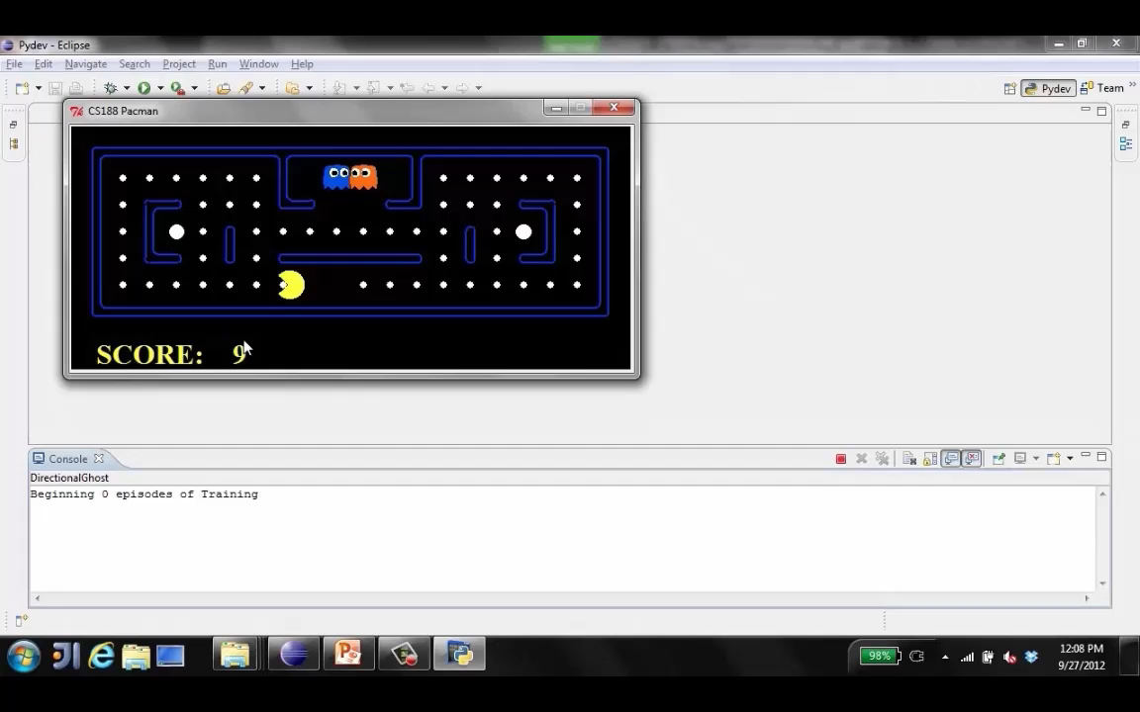
Approximate Q-Learning demo -- pacman
Credit: CS188 – Intro to AI, UC Berkeley, ai.berkeley.edu

Slide 40
Deep q-Learning: Approximate Q-Learning with Deep Neural Networks

Slide 41
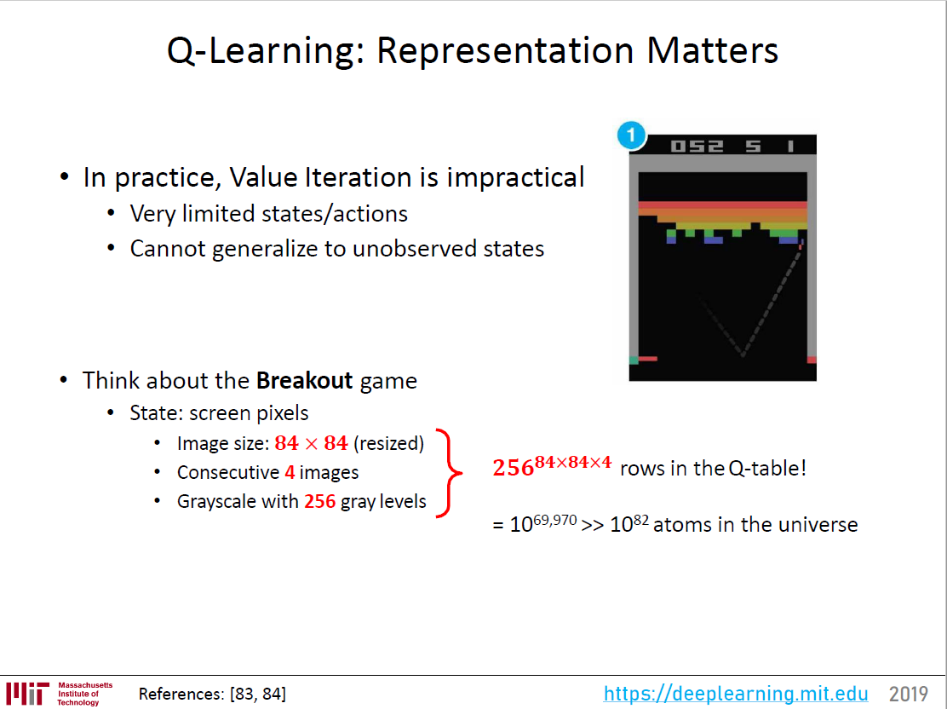
Tabular Q-Learning

Slide 42
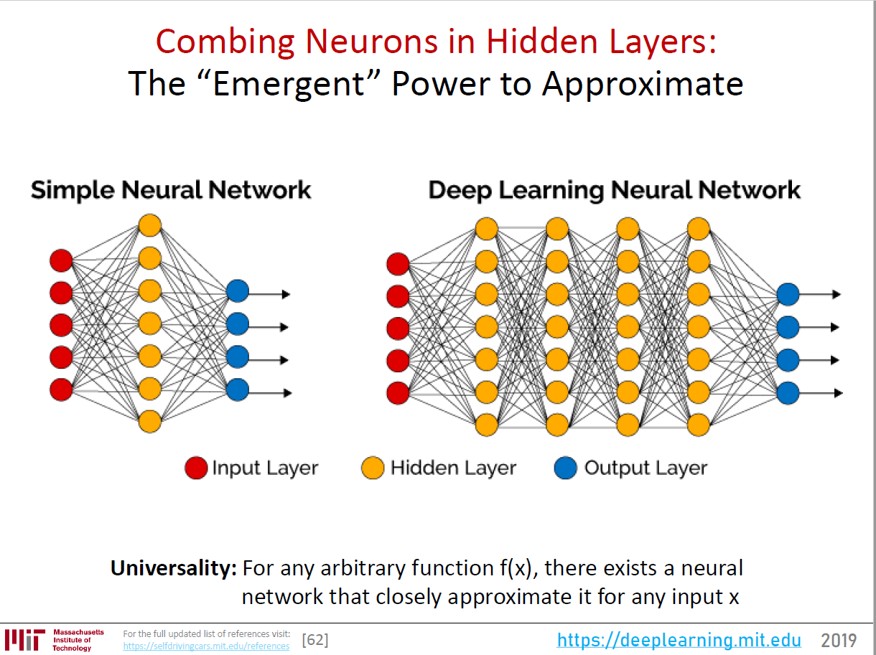

Slide 43
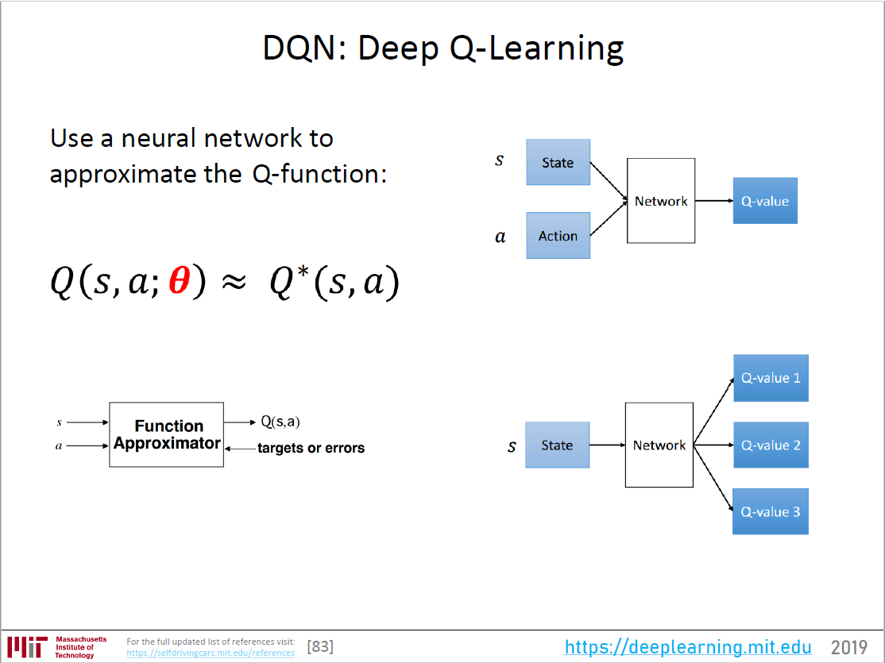

Slide 44
Extra slides

Slide 45
Editing^

Slide 46
Q-Learning update rule: An Alternate Interpretation
target
current
$$Q_{k+1} \left(s,a\right)←Q_{k}\left(s,a\right)+α\left[r+γ\max_{a′}{Q_{k}\left(s′,a′\right)}−Q_{k}\left(s,a\right)\right]$$
new
old
$$Q_{k+1} \left(s,a\right)←\left(1−α\right)Q_{k}\left(s,a\right)+α\left[r+γ\max_{a′}{Q_{k}\left(s′,a′\right)}\right]$$

